Slide 1
History and Society of Games
Session 01

Slide 2
OUTLINE
The First Video Games
The Studios
A Brief Overview of Genres
Audience and Demographics
Cultural Issues
Society within Games

Slide 3

THE FIRST VIDEO GAMES
1958 William Higinbotham, United States Department of Energy.
In 1950, people were wary of atomic power.
Laboratory tried to present a friendly image about atomic in 1958, William came up with interactive display.
Tennis for Two

Slide 4
Couple of hours – drew up the design with Robert V. Dvorak, a technical specialist.
Two days debugging and tuning the game.
Three weeks – the first video game was assembled.
Tennis for Two was the result
Became a big hit with visitors
Though it failed inspire future video games

Slide 5
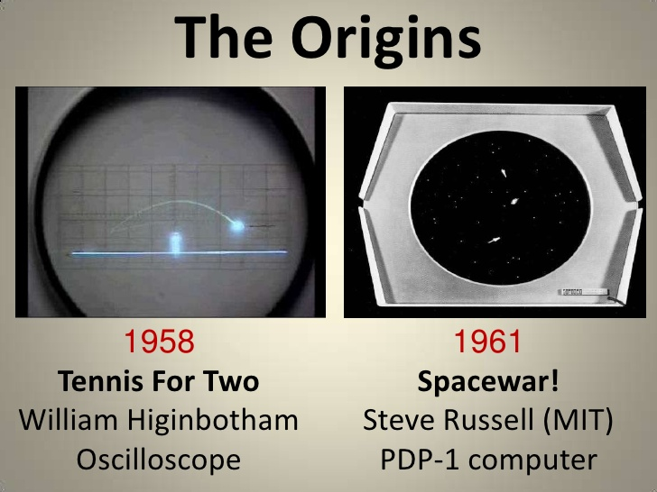

Slide 6
The Studios
Activision and Infocom
Formed by four former Atari programmers, Jim Levy (a former music industry executive).
merged with popular text adventure creator Infocom.
A name change to Mediagenic, then bankrupt.
Name change back to Activision lead us to the early 2000, continued to make Doom 3, Tony Hawk’s Underground, and Spider-Man.
Activision beat EA to become number one third-party publisher in 2007.

Slide 7
The Studios
Electronic Arts
Founded in 1982 by Trip Hawkins, former director of product marketing for Apple Computer
Acquire $2,000,000 in venture capital and putting $200,000 of his own money, Hawkins was able to bring to life ideas he’d had for 7 years.
May 1983, released its first five titles: Hard Hat Mack, Archon, Pinball Construction Set, Worms, MULE.

Slide 8
The Studios
Electronic Arts
Economic crisis of 2008 has hit the gaming industry hard. EA has strong franchises: James Bond 007, The Lord of the Rings, Madden NFL, Tiger Woods Golf, Need for Speed, Medal of Honor, battlefield, Harry Potter, The Sims, Spore, and Rock Band.

Slide 9
The Studios
Interplay
Formed in 1983
In 1985. created The Bard’s Tale
In 1987, created CRPG genre, Wasteland
in 1988, released William Gibson’s Neuromancer
and Battle Chess.
In 1990, financial troubles, released Castles, Baldurs Gate
In 1997, released Fallout

Slide 10
The Studios
LucasArts
Started in 1982, create Ball-blazer and Rescue on Fractalus.
in 1984, release Maniac Mansion
In 1997, produced The Curse of Monkey Island.
In 1988, release BattleHawks 1942, Their Finest Hour: The Battle of Britain, Secret Weapons of Luftwaffe
In 1992, Star Wars series
In 1995, Dark forces, released in 1995.
In 1998, Grim Fandango

Slide 11
The Studios
Blizzard
Starting in 1991 as Silicon & Synapse, then known as Blizzard Entertainment
Until 1993 creating console games: The Lost Vikings and Rock & Roll Racing.
In 1994, released Warcraft.
In 1995, released Warcraft II
Then create World of Warcraft, the fastest selling PC game in history.

Slide 12
The Studios
Id Software
Formed on 1991
Created Commander Keen.
Created game Wolfenstein 3D

Slide 13
A Brief Overview of Genres
Adventure
Action
Action-Adventure
Platformer
Fighting
First-Person Shooter
Real-Time Strategy (RTS)
Turn-Based Strategy
Role-Playing Game (RPG)
Massively Multiplayer Online Role-Playing Game (MMORPG)

Slide 14
A Brief Overview of Genres
Stealth
Survival Horror
Simulation
Racing
Sports
Rhythm
Puzzle
Mini-Games
Traditional
Educational
Serious

Slide 15

Audience and Demographics
ESA Statistics for the United States in 2008
The average game player’s age is 35 (up from 29 in 2003) [ESA04].
The average game buyer’s age is 40 (up from 36 in 2003).
40 percent of gamers are women, although individual consoles will skew those
numbers.
44 percent of online game players are women (up from 40% in 2003).
65 percent of American households play video games.

Slide 16
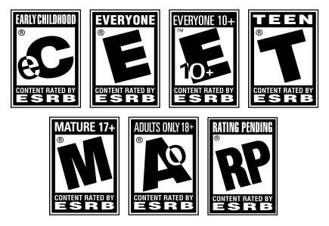
Audience and Demographics
The Entertainment Software Rating Board
More 2007 ESRB Statistics
57 percent of all games rated received an E for Everyone rating.
28 percent of all games rated received a T for Teen rating.
15 percent of all games rated received an M for Mature rating.
In 2007, 80 percent of the top 20 best-selling console games were rated E or T, while
75 percent of the top 20 best-selling computer games were rated either E or T.

Slide 17
Cultural Issues
Things that may be commonplace in one culture can have an entirely different connotation in another culture.
History can provide important guideposts in this area, while not necessarily providing all the answers.

Slide 18
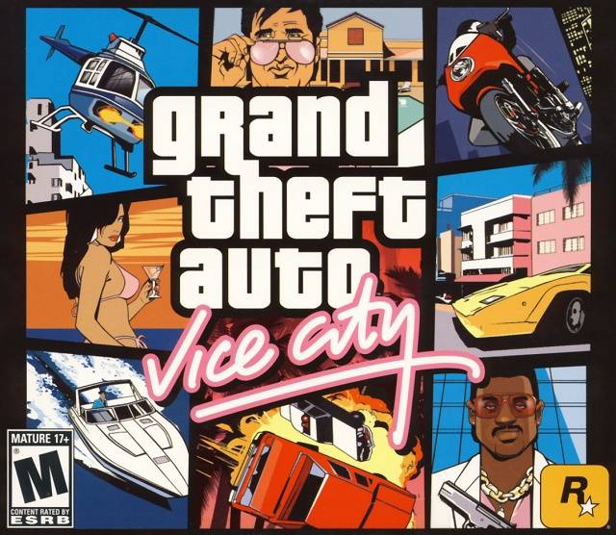
Cultural Issues
Worst . . . Stereotype . . . Ever

Slide 19
Cultural Issues
Worst . . . Stereotype . . . Ever
Grand Theft Auto: Vice City
Shadow Warrior
The Simpsons, the TV show

Slide 20
Cultural Issues
Foreign Diplomacy
A global release brings its own set of issues
Games can be banned outright in some countries

Slide 21
Cultural Issues
Foreign Diplomacy
Germany
sensitive to its past
Some games can avoid being placed on the list by changing a few controversial elements (red blood to green blood, for example).
Ultimately, a banned list game cannot be advertised, displayed in stores, or be sold to people under 18

Slide 22
Cultural Issues
Foreign Diplomacy
China
the 2002 PC game Hearts of Iron by Swedish company Paradox was banned by China’s Ministry of Culture for “distorting history and damaging China’s sovereignty and territorial integrity
Websites, Sellers, and all CD-ROM were prohibited and confiscated

Slide 23
Cultural Issues
Foreign Diplomacy
Japan
EA’s Medal of Honor: Rising Sun depicts, among other things, the Japanese attack on Pearl Harbor.
Japanese gamers were unconcerned with the idea that they were killing their grandfathers, and concentrated instead on the gameplay

Slide 24
Cultural Issues
Cultural Acceptance
It’s not a simple thing to make clear-cut rules about what will find acceptance within others’ cultures.
Certain cultures will ban a game specifically for a depiction of history that disagrees with what they believe
Cultural sensitivity is a minefield, where only the strongest instances of offense are clearly problematic

